Slide 1
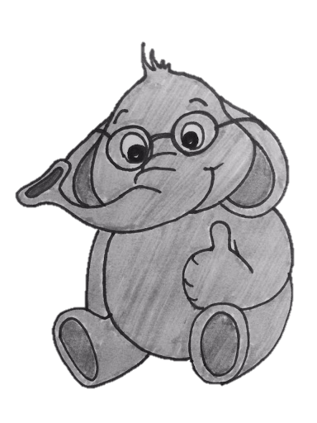
Randomized Admission Policy for Efficient Top-k and Frequency Estimation
By: Ran Ben Basat, Technion, Israel
Based on a joint work with Gil Einziger, Roy Friedman, and Yaron Kassner
IEEE INFOCOM2017

Slide 2
Motivation
Computing network statistics.
Load balancing, Fairness, Anomaly detection.
Monitoring a large number of flows.
Allowing real-time queries.

Slide 3
Frequency Estimation
How many packets has sent? How about ?
Can’t allocate a counter for each flow!
7
8
8
7
3
5
1
0
7
2
8
7
3
4
1
0
7
8
8
7
3
5
1
0
7
2
8
7
3
4
1
0
7
3
4
1
0
7
8
8
7
3
5
1
0
7
2
8
7
3
4
1
0
7
2
8
7
3
4
1
0
7
3
4
1
0
7
8
8
7
3
5
1
0
7
2
8
7
3
4
1
0

Slide 4
Space Saving (Metwally et al.)
When queried for an element that has a counter, we return its value.
Query( ) returns 3
When queried for unmonitored element, return the value of the minimal counter.
Query ( ) returns 2
For a N-sized stream, when allocated with m counters, Space Saving guarantees:
$$f_{x}≤Query\left(x\right)≤f_{x}+\frac{N}{m}$$
Keep a set of m counters.
Each counter keeps the ID of the associated item.
If an element that had a counter arrives, increase its value by one.
If an element without a counter arrive, allocate it with the minimal counter and increment.
For top-k, simply return the IDs of the largest counters (e.g., guess the most frequent element to be ).
For achieving an $Nε$approximation, $⌈1/ε⌉$ counters are needed.
Value
ID
2
0
1
3
2
0
1

Slide 5
Space Saving (Metwally et al.)
Invented in the Database community.
Works great on skewed data, where a small fraction of the elements appear most of the times.
But not that well when data is heavy tailed, which is often the case in flow monitoring.

Slide 6
Illustration

Slide 7
The solution
- Probabilistic Admission

Slide 8
Limited Associativity
Randomly distribute elements into small size algorithm instances.
$$h\left(\right)=5$$
Implementing constant size instances reduce data structures complexity to (nearly) zero.
0
1
2
3
4
5
6
7

Slide 9
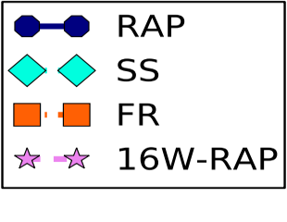
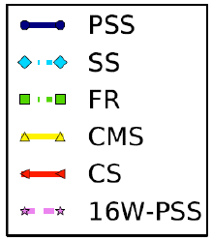
Evaluation
– Top-$k$
How many counters are needed to identify top-32?

Slide 10
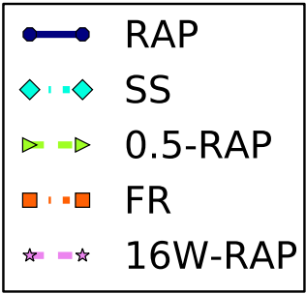
Evaluation
– Top-$k$
Which precision can we achieve for retrieving 50% of the top-512?

Slide 11
Evaluation
– Top-$k$
How fast does the take for the algorithms to converge?

Slide 12
Evaluation
– Frequency Estimation
How well can we estimate the sender’s packet count?

Slide 13
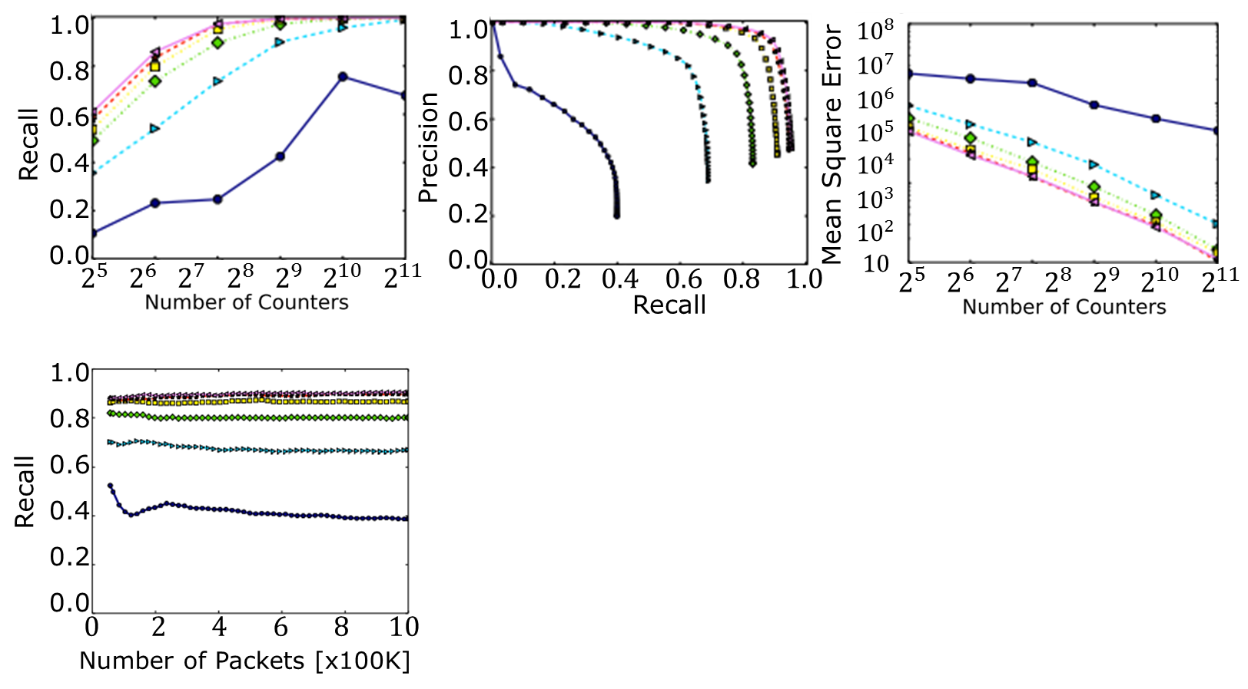
Limited Associativity Effect

Slide 14
Takeaways
Randomization allows effective filtering of tail items and increased accuracy.
Small associativity allows data structure-less implementation – saving space and time.

Slide 15
Any Questions

Slide 16
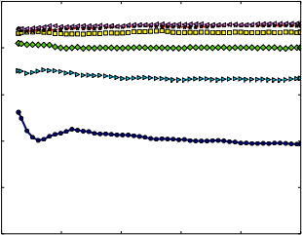
1.0
0.8
0.6
0.4
0.2
0.0
1.0
0.8
0.6
0.4
0.2
0.0
$${10}^{8}$$
$${10}^{7}$$
$${10}^{6}$$
$${10}^{5}$$
$${10}^{4}$$
$${10}^{3}$$
$${10}^{2}$$
$$10$$
Recall
Precision
Mean Square Error
$$2^{5} 2^{6} 2^{7} 2^{8} 2^{9} 2^{10} 2^{11}$$
$$0.0 0.2 0.4 0.6 0.8 1.0$$
$$2^{5} 2^{6} 2^{7} 2^{8} 2^{9} 2^{10} 2^{11}$$
Recall
1.0
0.8
0.6
0.4
0.2
0.0
Recall
$$0 2 4 6 8 10$$
Number of Packets [x100K]

Slide 17
$${10}^{9}$$
$${10}^{8}$$
$${10}^{7}$$
$${10}^{6}$$
$${10}^{5}$$
$${10}^{4}$$
$${10}^{3}$$
$${10}^{9}$$
$${10}^{8}$$
$${10}^{7}$$
$${10}^{6}$$
$${10}^{5}$$
$${10}^{4}$$
$${10}^{3}$$
$${10}^{2}$$
$$10$$
$${10}^{8}$$
$${10}^{7}$$
$${10}^{6}$$
$${10}^{5}$$
$${10}^{4}$$
$${10}^{3}$$
$${10}^{2}$$
$$10$$
Mean Square Error
Mean Square Error
Mean Square Error
$$2^{5} 2^{6} 2^{7} 2^{8} 2^{9} 2^{10} 2^{11}$$
$$2^{5} 2^{6} 2^{7} 2^{8} 2^{9} 2^{10} 2^{11}$$
$$2^{5} 2^{6} 2^{7} 2^{8} 2^{9} 2^{10} 2^{11}$$

Slide 18
1.0
0.8
0.6
0.4
0.2
0.0
1.0
0.8
0.6
0.4
0.2
0.0
1.0
0.8
0.6
0.4
0.2
0.0
Recall
Recall
Recall
$$0 2 4 6 8 10$$
$$0 2 4 6 8 10$$
$$0 2 4 6 8 10$$
Number of Packets [x100K] Number of Packets [x100K] Number of Videos [x100K]

Slide 19
1.0
0.8
0.6
0.4
0.2
0.0
1.0
0.8
0.6
0.4
0.2
0.0
1.0
0.8
0.6
0.4
0.2
0.0
Precision
Precision
Precision
$$0.0 0.2 0.4 0.6 0.8 1.0$$
$$0.0 0.2 0.4 0.6 0.8 1.0$$
$$0.0 0.2 0.4 0.6 0.8 1.0$$
Recall Recall Recall

Slide 20
1.0
0.8
0.6
0.4
0.2
0.0
1.0
0.8
0.6
0.4
0.2
0.0
1.0
0.8
0.6
0.4
0.2
0.0
Recall
Recall
Recall
$$2^{5} 2^{6} 2^{7} 2^{8} 2^{9} 2^{10} 2^{11}$$
$$2^{5} 2^{6} 2^{7} 2^{8} 2^{9} 2^{10} 2^{11}$$
$$2^{5} 2^{6} 2^{7} 2^{8} 2^{9} 2^{10} 2^{11}$$

