Slide 1
Heavy Hitters in Streams and Sliding Windows
By: Ran Ben Basat, Technion, Israel
Based on a joint work with Gil Einziger, Roy Friedman, and Yaron Kassner

Slide 2
Motivation
Computing network statistics.
Load balancing, Fairness, Anomaly detection, etc.
Monitoring a large number of flows.
Allowing real-time queries.
Sliding window support.

Slide 3
Frequency Estimation
Given a stream of elements
How many times 7 has appeared? How about 5?
Not enough fast memory (e.g., SRAM) to keep a counter for each element.
7
8
8
7
3
5
1
0
7
2
8
7
3
4
1
0
7
8
8
7
3
5
1
0
7
2
8
7
3
4
1
0
7
3
4
1
0
7
8
8
7
3
5
1
0
7
2
8
7
3
4
1
0
7
2
8
7
3
4
1
0
7
3
4
1
0
7
8
8
7
3
5
1
0
7
2
8
7
3
4
1
0

Slide 4
Space Saving (Metwally et al.)
When queried for an element that has a counter, we return its value.
Query(7) returns 3
When queried for unmonitored element, return the value of the minimal counter.
Query(3) returns 2
Keep a set of m counters.
Each counter keeps the ID of the associated item.
If an element that had a counter arrives, increase its value by one.
If an element without a counter arrive, allocate it with the minimal counter and increment.
For a N-sized stream, when allocated with m counters, Space Saving guarantees:
$$f_{x}≤Query\left(x\right)≤f_{x}+\frac{N}{m}$$
For achieving a $Nε$approximation, $⌈1/ε⌉$ counters are needed.
Value
ID
7
7
3
7
0
7
2
0
1
3
2
0
3
1
0

Slide 5
Original Implementation
Value = 6
Value = 8
Value = 182
…
ID = x
ID = z
ID = w
ID = y

Slide 6
Sorted Array of Increasing Length (SAIL)
After processing N elements, the k’th largest counter cannot exceed N/k.
$$\log{N/m} bits$$
$$Memory saving$$
$$\log{N} bits$$

Slide 7
Keeping the Array Sorted
For incrementing a counter, we swap it with the last counter with the same value.
5
Takes O(log m) using binary search, or O(1) if we store the last counter’s index.
7
7
7
7
8
8

Slide 8
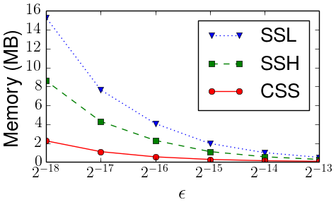
CSS Evaluation
$$O(1)$$
$$O(\log{1/ε)}$$
$$O(1)$$

Slide 9
From Streams to Sliding Windows
A stream of elements
How many times have 7 appeared within the last W items?
0
7
2
8
7
3
4
1
0
7
3
4
1
0
7
8
8
7
3
5
1
0
7
2
8
7
3
4
1
0
7
8
8
7
3
5
1
0
7
2
8
7
3
4
1
0
7
8
8
7
3
5
1
0
7
2
8
7
3
4
1
0
7
3
4
1
0
7
8
8
7
3
5
1
0
7
2
8
7
3
4
1
0
7
2
8
7
3
4
1
0
7
3
4
1
0
7
8
8
7
3
5
1
0
7
2
8
7
3
4
1
0
$W$ elements

Slide 10
Window Algorithm
Break the stream into W-sized frames
Break each frame into k equal sized blocks
4
1
0
7
3
4
1
0
7
8
8
7
3
5
1
0
7
2
8
7
3
4
1
0

Slide 11
Window Algorithm
We track the elements’ frequency using counters.
Every time a counter hits a multiple of W/k, we say it overflowed and mark the current block.
7,8
7
7
5

Slide 12
Answering Queries
Given a query(x), we multiply its number of window overflows by the block size.
Query(3) = 0, Query(7) = 2W/k
For a W-sized window, when allocated with m counters, our algorithm guarantees:
$$f_{x}≤Query\left(x\right)≤f_{x}+4W/m$$
7,8
7
7
5

Slide 13
Challenges
7,8,3
7
5
Counting the number of overflows per item in O(1).
Using a static hash table.
Updating the hash table when block ends.
Using deamortization to gradually empty the block’s list.
0
0
207
522
The counters space consumption grows.
“Flush” the CSS instance whenever a frame ends.
Too many elements in the window.
Use CSS instance to reduce space requirement.
0
0
233
682
0
0
316
897
0
0
461
978
0
0
463
1236
0
0
788
1678
$$1$$
0
$$1$$
0
$$C\left[7\right]= ,C\left[8\right]= ,$$
$$C\left[3\right]= , C\left[5\right]= ,$$
$$2$$
$$0$$
$$2$$
$$0$$
$$1$$
976
$$1$$
4147
$$1$$
$$1$$
$$1$$
$$0$$
$$0$$

Slide 14
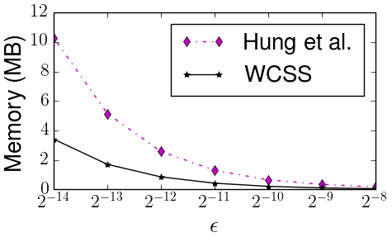
Evaluation
$$O\left(\frac{1}{ε}\right)$$
$$O\left(1\right)$$

Slide 15
Open Source
https://github.com/ kassnery/frugal-counting

Slide 16
Summary
Efficient, static memory based, implementation of Space Saving.
The first sliding window frequency approximation algorithm allowing O(1) data processing and queries.

Slide 17
Any Questions

