Slide 1
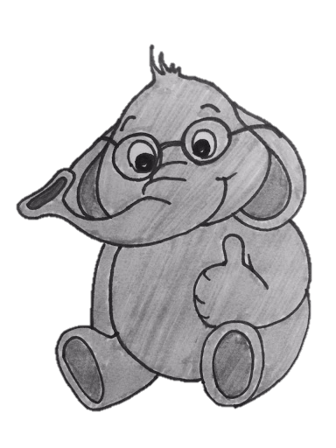
Pay for a Sliding Bloom Filter and Get Counting, Distinct Elements, and Entropy for Free
By: Ran Ben Basat, Technion, Israel
Joint work with Eran Assaf, Gil Einziger, and Roy Friedman
IEEE INFOCOM2018

Slide 2
Motivation
Computing network statistics.
Load balancing, Fairness, Anomaly detection.
Monitoring a large number of flows.
Allowing real-time queries.

Slide 3
Sliding Bloom Filter
Did appear in the window?
Recent data is often the most important!
No false negatives:
$$Pr\left[\text{yes} | x∈W\right]=1$$
Few false positives:
$$Pr\left[\text{yes} | x∉W\right]≤ε$$
Traditionally – must fit in the SRAM
7
8
8
7
3
5
1
0
7
2
8
7
3
4
1
0
7
8
8
7
3
5
1
0
7
2
8
7
3
4
1
0
7
3
4
1
0
7
8
8
7
3
5
1
0
7
2
8
7
3
4
1
0
7
2
8
7
3
4
1
0
7
3
4
1
0
7
8
8
7
3
5
1
0
7
2
8
7
3
4
1
0
Year | 2012 | 2014 | 2016
SRAM (MB) | 10-20 | 30-60 | 50-100
(SilkRoad, SIGCOMM 2017)

Slide 4
Lower Bounds for Sliding Bloom Filters
Any sliding Bloom filter must $𝔅=Wlog\left(W/ε\right)$ bits. (Naor and Yogev, ISAAC 2013)
For convenience we assume that $ε=W^{o\left(1\right)}.$
Alternatively, $\log\left(W/ε\right)=\log{W}(1+o\left(1\right))$
An algorithm is called succinct if it uses $𝔅\left(1+o\left(1\right)\right)$ space.

Slide 5
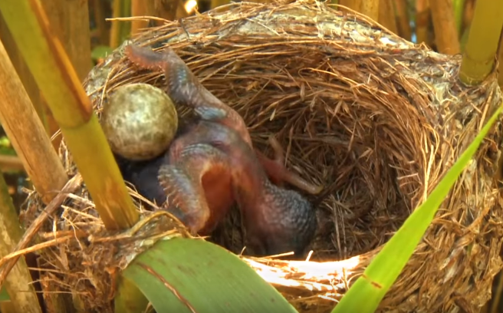
Sliding Window Bloom Filter (Liu et al., INFOCOM 2013)
$$0$$
$$1$$
$$2$$
$$3$$
$$4$$
Use a Cuckoo Hash Table.
Current time:
Table 1
Thm: if the load factor is $≤0.5$then with high probability all operations take constant time
Table 2
FP | Timestamp
FP | Timestamp
$$110$$
$$2$$
$$3$$
$$4$$
$$1$$
$$1$$
$$3$$
Space: $2WlogW\left(1+o\left(1\right)\right)=𝔅\left(2+o\left(1\right)\right)$ bits
$$h_{1}\left( \right)$$
$$h_{1}\left( \right)$$
$$h_{2}\left( \right)$$
$$h_{1}\left( \right)$$
$$h_{1}\left( \right)$$
$$h_{2}\left( \right)$$
$$h_{0}\left( \right)$$
Has appeared
in the last 3 packets?

Slide 6
Per-flow frequency estimation
How many times does appear in the window?
A generalization of a Sliding Bloom Filter
$Wε−$Additive approximation using $O\left(ε^{−1}\log{W}\right)$ bits and with constant time operations (Ben Basat et al., INFOCOM 2016)

Slide 7
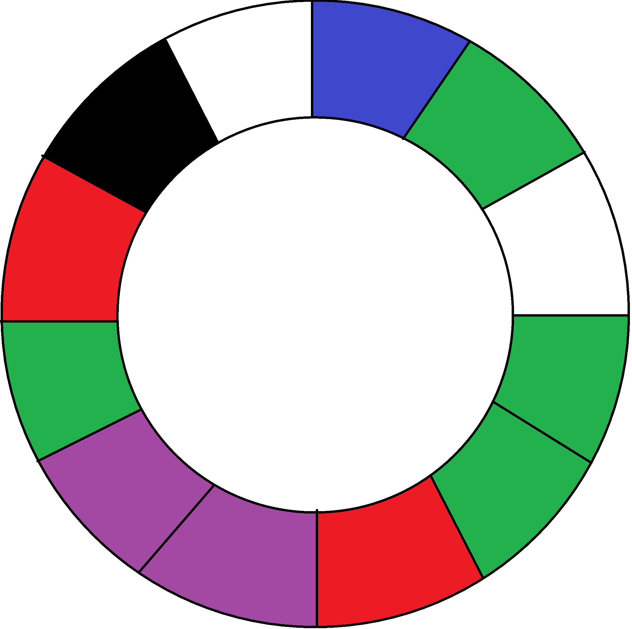
Sliding Window Approximate Measurement Protocol (SWAMP)
Current Item Pointer (curr)
Cyclic Fingerprint Buffer (CFB)

Slide 8
Multiset representations
Consider representing a set of $m$ items from an $n$-sized universe.
replace( , )
Universe:
multiplicity( )
Set:
There exist succinct (use $𝔅(m,n)\left(1+o\left(1\right)\right)$ bits) representations with $O(1)$ time operations.
(Einziger and Friedman, ICDCN 2016), (Pandey et al., SIGMOD 2017)

Slide 9
Sliding Window Approximate Measurement Protocol (SWAMP)
replace( , )
Current Item Pointer (curr)
Fingerprint | Frequency
 | 2
 | 1
 | 2
 | 2
 | 4
 | 1
(+1)
(-1)
Cyclic Fingerprint Buffer (CFB)
Aggregates Table

Slide 10
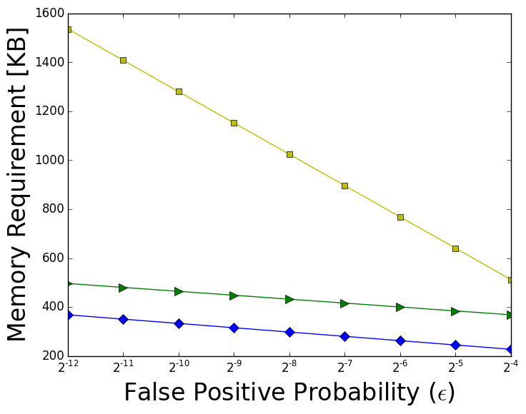
The results
Algorithm | Space | Update Time | Counts
TBF | $$O\left(WlogWlogε^{−1}\right)$$ | $$O\left(logε^{−1}\right)$$
SWBF | $$\left(2+o\left(1\right)\right)W\log_{2}W$$ | $$O(1)$$
SWAMP | $$\left(1+o\left(1\right)\right)W\log_{2}W$$ | $$O(1)$$

Slide 11
Is SWAMP a good counting algorithm?
We compared to the state of the art WCSS algorithm (Ben Basat et al., INFOCOM 2016)

Slide 12
Counting distinct elements over sliding windows
How many distinct flows appear in the window?
$(1+ε)−$multiplicative approximation using $O\left(ε^{−2}\log{W}\log{\log{W}}\right)$ bits and with constant update time (Fusy and Giroire, ANALCO 2007), (Chabchoub and Hebrail, ICDM 2010),

Slide 13
Counting distinct elements with SWAMP
Distinct Fingerprints:
$Z=$6
(-1)
Requires just $logW$ bits!
Current Item Pointer (curr)
Fingerprint | Frequency
 | 2
 | 1
 | 2
 | 2
 | 4
 | 1
Cyclic Fingerprint Buffer (CFB)
Aggregates Table

Slide 14
Counting distinct elements with SWAMP
Guarantees:
$$\operatorname{Pr}\left[D≥Z\right]=1$$
$$\operatorname{Pr}\left[D−Z≥εDlogδ^{−1}\right]≤δ$$
(never overestimate, likely to not underestimate by much)
(approximate) Maximum Likelihood Estimate:
Return $\frac{\ln\left(1 − \frac{Z}{2^{L}}\right)}{\ln\left(1 − \frac{1}{2^{L}}\right)}$

Slide 15
Counting distinct elements with SWAMP
Instead of paying $Ω\left(ε^{−2}logW\right)$ bits using the existing algorithms, SWAMP required $O(Wlog(W/ε))$ which is more efficient when $ε$ is small

Slide 16
Takeaways
A succinct sliding bloom filter that can also count.
Beats the state of the art for:
Sliding Bloom Filter
Per-flow Frequency Estimation
Counting Distinct Elements
Computing Entropy (in the paper)

Slide 17
Any Questions

Slide 18
Distribution Entropy over Sliding Windows
What is the distribution entropy of the window?
$(1+ε)−$multiplicative approximation using $O\left(ε^{−2}\log{W}\right)$ bits and with $O\left(ε^{−2}\right)$ update time (Braverman et al., PODS 2009).

Slide 19
Computing Entropy with SWAMP
We can track $\hat{H} −$the entropy of the finger print distribution
Guarantees:
$$\operatorname{Pr}\left[H≥\hat{H}\right]=1$$
$$\operatorname{Pr}\left[H−\hat{H}≥ε\right]≤δ$$

Slide 20
Computing Entropy with SWAMP
Instead of paying $Ω\left(ε^{−2}logW\right)$ bits using the existing algorithms, SWAMP required $O(Wlog(W/ε))$ which is more efficient when $ε$ is small

Slide 21
Set Membership (Bloom Filter)
Did appear in the stream? How about ?
Can’t allocate a bit for each potential flow!
Traditionally – must fit in the SRAM
Year | 2012 | 2014 | 2016
SRAM (MB) | 10-20 | 30-60 | 50-100
7
8
8
7
3
5
1
0
7
2
8
7
3
4
1
0
7
8
8
7
3
5
1
0
7
2
8
7
3
4
1
0
7
3
4
1
0
7
8
8
7
3
5
1
0
7
2
8
7
3
4
1
0
7
2
8
7
3
4
1
0
7
3
4
1
0
7
8
8
7
3
5
1
0
7
2
8
7
3
4
1
0
(SilkRoad, SIGCOMM 2017)

Slide 22
The Bloom Filter (Bloom, 1970)
Use a bit-array of size $m$ and $k$ hash functions $h_{i}:U→\left\{1,…,m\right\}$
No False Negatives!
Few False Positives.
Has appeared?
0 | 0 | 0 | 0 | 0 | 0 | 0 | 0 | 0 | 0 | 0 | 0 | 0 | 0 | 0 | 0 | 0 | 0 | 0 | 0 | 0 | 0 | 0 | 0 | 0 | 0 | 0 | 0 | 0 | 0 | 0 | 0 | 0 | 0 | 0 | 0 | 0 | 0 | 0 | 0
0 | 0 | 0 | 1 | 0 | 0 | 0 | 0 | 0 | 0 | 1 | 0 | 0 | 0 | 0 | 0 | 0 | 0 | 0 | 1 | 0 | 0 | 0 | 0 | 0 | 0 | 0 | 0 | 0 | 0 | 0 | 0 | 0 | 0 | 0 | 0 | 0 | 1 | 0 | 0
0 | 1 | 0 | 1 | 0 | 0 | 0 | 0 | 0 | 0 | 1 | 0 | 0 | 1 | 0 | 0 | 0 | 0 | 0 | 1 | 0 | 0 | 0 | 0 | 0 | 0 | 0 | 0 | 0 | 0 | 0 | 0 | 1 | 0 | 0 | 0 | 0 | 1 | 0 | 0
0 | 1 | 0 | 1 | 0 | 1 | 0 | 0 | 1 | 0 | 1 | 0 | 1 | 1 | 0 | 0 | 0 | 0 | 1 | 1 | 0 | 0 | 0 | 0 | 0 | 0 | 0 | 0 | 0 | 0 | 0 | 0 | 1 | 0 | 0 | 0 | 0 | 1 | 0 | 0

Slide 23
The Timing Bloom Filter (Zhang and Guan, ICDCS 2008)
Use a timestamp-array of size $m$ and $k$ hash functions $h_{i}:U→\left\{1,…,m\right\}$
$$0$$
$$1$$
$$2$$
$$3$$
$$4$$
$$5$$
Current time:
Space: $O\left(WlogWlogε^{−1}\right)$
Update/Query: $O\left(logε^{−1}\right)$
Has appeared in the last 3 packets?
0 | 0 | 0 | 0 | 0 | 0 | 0 | 0 | 0 | 0 | 0 | 0 | 0 | 0 | 0 | 0 | 0 | 0 | 0 | 0 | 0 | 0 | 0 | 0 | 0 | 0 | 0 | 0 | 0 | 0 | 0 | 0 | 0 | 0 | 0 | 0 | 0 | 0 | 0 | 0
0 | 2 | 0 | 4 | 0 | 3 | 0 | 0 | 3 | 0 | 4 | 0 | 3 | 2 | 0 | 0 | 0 | 0 | 3 | 4 | 0 | 0 | 0 | 0 | 0 | 0 | 0 | 0 | 0 | 0 | 0 | 0 | 2 | 0 | 0 | 0 | 0 | 4 | 0 | 0
0 | 2 | 0 | 4 | 0 | 3 | 0 | 0 | 3 | 0 | 4 | 0 | 3 | 2 | 0 | 5 | 0 | 0 | 3 | 5 | 0 | 0 | 0 | 0 | 0 | 5 | 0 | 0 | 0 | 0 | 0 | 0 | 2 | 0 | 0 | 0 | 0 | 5 | 0 | 0
0 | 0 | 0 | 1 | 0 | 0 | 0 | 0 | 0 | 0 | 1 | 0 | 0 | 0 | 0 | 0 | 0 | 0 | 0 | 1 | 0 | 0 | 0 | 0 | 0 | 0 | 0 | 0 | 0 | 0 | 0 | 0 | 0 | 0 | 0 | 0 | 0 | 1 | 0 | 0
0 | 2 | 0 | 1 | 0 | 0 | 0 | 0 | 0 | 0 | 1 | 0 | 0 | 2 | 0 | 0 | 0 | 0 | 0 | 2 | 0 | 0 | 0 | 0 | 0 | 0 | 0 | 0 | 0 | 0 | 0 | 0 | 2 | 0 | 0 | 0 | 0 | 1 | 0 | 0
0 | 2 | 0 | 1 | 0 | 3 | 0 | 0 | 3 | 0 | 1 | 0 | 3 | 2 | 0 | 0 | 0 | 0 | 3 | 2 | 0 | 0 | 0 | 0 | 0 | 0 | 0 | 0 | 0 | 0 | 0 | 0 | 2 | 0 | 0 | 0 | 0 | 1 | 0 | 0

Slide 24
Any Questions

Slide 25
Any Questions

Slide 26
Sliding Window Approximate Measurement Protocol (SWAMP)
$${h(x}_{n})=$$
Current Item Pointer (curr)
Cyclic Fingerprint Buffer (CFB)

Slide 27
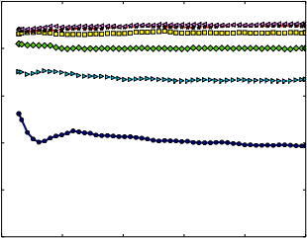
1.0
0.8
0.6
0.4
0.2
0.0
1.0
0.8
0.6
0.4
0.2
0.0
$${10}^{8}$$
$${10}^{7}$$
$${10}^{6}$$
$${10}^{5}$$
$${10}^{4}$$
$${10}^{3}$$
$${10}^{2}$$
$$10$$
Recall
Precision
Mean Square Error
$$2^{5} 2^{6} 2^{7} 2^{8} 2^{9} 2^{10} 2^{11}$$
$$0.0 0.2 0.4 0.6 0.8 1.0$$
$$2^{5} 2^{6} 2^{7} 2^{8} 2^{9} 2^{10} 2^{11}$$
Recall
1.0
0.8
0.6
0.4
0.2
0.0
Recall
$$0 2 4 6 8 10$$
Number of Packets [x100K]

Slide 28
$${10}^{9}$$
$${10}^{8}$$
$${10}^{7}$$
$${10}^{6}$$
$${10}^{5}$$
$${10}^{4}$$
$${10}^{3}$$
$${10}^{9}$$
$${10}^{8}$$
$${10}^{7}$$
$${10}^{6}$$
$${10}^{5}$$
$${10}^{4}$$
$${10}^{3}$$
$${10}^{2}$$
$$10$$
$${10}^{8}$$
$${10}^{7}$$
$${10}^{6}$$
$${10}^{5}$$
$${10}^{4}$$
$${10}^{3}$$
$${10}^{2}$$
$$10$$
Mean Square Error
Mean Square Error
Mean Square Error
$$2^{5} 2^{6} 2^{7} 2^{8} 2^{9} 2^{10} 2^{11}$$
$$2^{5} 2^{6} 2^{7} 2^{8} 2^{9} 2^{10} 2^{11}$$
$$2^{5} 2^{6} 2^{7} 2^{8} 2^{9} 2^{10} 2^{11}$$

Slide 29
1.0
0.8
0.6
0.4
0.2
0.0
1.0
0.8
0.6
0.4
0.2
0.0
1.0
0.8
0.6
0.4
0.2
0.0
Recall
Recall
Recall
$$0 2 4 6 8 10$$
$$0 2 4 6 8 10$$
$$0 2 4 6 8 10$$
Number of Packets [x100K] Number of Packets [x100K] Number of Videos [x100K]

Slide 30
1.0
0.8
0.6
0.4
0.2
0.0
1.0
0.8
0.6
0.4
0.2
0.0
1.0
0.8
0.6
0.4
0.2
0.0
Precision
Precision
Precision
$$0.0 0.2 0.4 0.6 0.8 1.0$$
$$0.0 0.2 0.4 0.6 0.8 1.0$$
$$0.0 0.2 0.4 0.6 0.8 1.0$$
Recall Recall Recall

Slide 31
1.0
0.8
0.6
0.4
0.2
0.0
1.0
0.8
0.6
0.4
0.2
0.0
1.0
0.8
0.6
0.4
0.2
0.0
Recall
Recall
Recall
$$2^{5} 2^{6} 2^{7} 2^{8} 2^{9} 2^{10} 2^{11}$$
$$2^{5} 2^{6} 2^{7} 2^{8} 2^{9} 2^{10} 2^{11}$$
$$2^{5} 2^{6} 2^{7} 2^{8} 2^{9} 2^{10} 2^{11}$$

