Slide 1
Network-Wide Routing Oblivious Heavy Hitters
By: Ran Ben Basat, Technion ($→$ Harvard)
Based on a joint work with
Gil Einziger (Nokia Bell Labs), Shir Landau Feibish (Princeton), Jalil Moraney and Danny Raz (Technion)

Slide 2
Motivation
Computing network statistics.
Load balancing, Fairness, Anomaly detection.
Monitoring a large number of flows.
Allowing network-wide analysis.

Slide 3
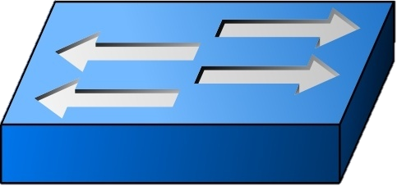
Example
What is the overall number of sent packets?
Which flows sent more than 1% of the packets?
How many packets has sent?
Routing Oblivious:
Assume no routing knowledge
Routing may arbitrarily change over time
Distributed Implementation

Slide 4
A possible solution
Tag every packet when seen by the first switch (Afek et al., 2018)
Use one of the unused bits in the packet header.
Only the first switch counts the packet.
Issues:
Hard to untag packets before leaving the network.
An attacker can avoid detection by tagging its packets.
Bases on the assumption that the bit arrives cleared to the network.

Slide 5
Single Measurement Point
How many times has appeared?
Consider a sample of size $z=O\left(ε^{−2}\log{δ^{−1}}\right)$.
Define: $\hat{f_{x}}=\#x\frac{N}{z}$
e.g., $N=50, z=10$
$$\hat{f }$$
$$\hat{f }$$
$$=15$$
$$=0$$
7
8
8
7
3
5
1
0
7
2
8
7
3
4
1
0
7
8
8
7
3
5
1
0
7
2
8
7
3
4
1
0
7
3
4
1
0
7
8
8
7
3
5
1
0
7
2
8
7
3
4
1
0
7
2
8
7
3
4
1
0
7
3
4
1
0
7
8
8
7
3
5
1
0
7
2
8
7
3
4
1
0
Thm: $\operatorname{Pr}\left[\left|f_{x}−\hat{f_{x}}\right|>Nε\right]≤δ$

Slide 6
Sampling Implementation
We do not know the number of packets in advance
One could use reservoir sampling
Hash-based sampling
Assume that each packet has a distinct (e.g., TCP or IP) identifier

Slide 7
Hash-based sampling
Apply a hash function $h:ID×SN→\left[0,1\right]$
Store the $z$ packets with the highest hash value
e.g., $z=3$
517
321
518
518
322
$$h=0.6$$
$$h=0.7$$
$$h=0.2$$
$$h=0.9$$
$$h=0.8$$

Slide 8
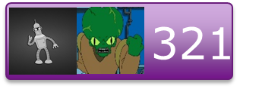
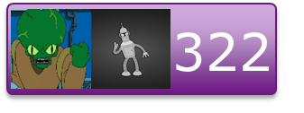
Distributed Sampling
The highest hash values among the local maximas are global maximas
517
321
518
518
322

Slide 9
Distributed Sampling Application
By sampling$O\left(ε^{−2}\log{δ^{−1}}\right)$ packets (e.g., 240k for $ε=δ=1\%$) we can find the heavy hitters
Large flows will be appear frequently in the sample.
But how can we approximate flow sizes without knowing the number of packets?

Slide 10
Count Distinct Algorithms
Given a stream of elements $S=x_{1},x_{2},…$, how many distinct elements are in $S$?
Admits a constant update time $\left(1+ε\right)$-approximate solution.
Can be merged, given a summaries for $S_{1}$ and $S_{2}$, we can compute a summary for $S_{1}∪S_{2}$.
Each switch will maintain a summary for its local stream. The controller will merge all summaries.

Slide 11
Measuring Goodput and Throughput
Depending on the application, we can measure:
Throughput
Use the IP ID field as a packet identifier
TCP Goodput
Use the TCP Sequence Number field as a packet identifier
Retransmissions are not double-counted

Slide 12
Extensions
Byte-size based measurements
Identifying Frequent paths
Estimate Retransmission Rates
Allow deployment only at a subset of the switches

Slide 13
Any Questions

Slide 14
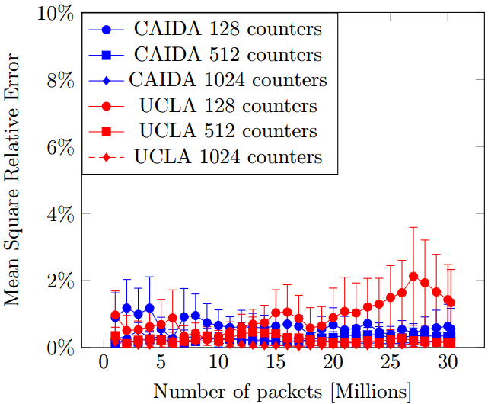
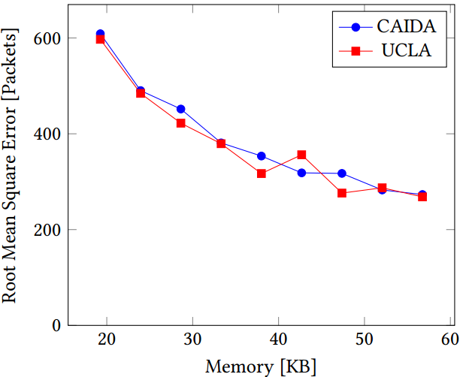
Evaluation

Slide 15
Any Questions

